Slide 1


Slide 2
UNISENDER
This project is about sending Emails and SMS using Node.js through web service.
How does it work?
We made use of packages and few services provided by nexmo messaging server in Node.js to send emails and text messages.Nodemailer is a builtin package that comes with Node.js and nexmo is another builtin package that lets us use the sms services provided by nexmo.Intially you need to create an accont with Nexmo to use the sms services.You can use the trial version where in you will be given limited number of messages.You need to subscribe a plan to customise the message content and add your custom numbers.All the registered users can send both emails and messages using a single appliaction which is the main objective behind using UNISENDER.

Slide 3
TECHNOLOGIES USED:
ANGULAR JS
NODE JS
MONGODB
EXPRESS JS
BOOTSTRAP
HTML

Slide 4
WHAT IS ANGULAR?
AngularJS is a JavaScript-based open-source front-end web application framework mainly maintained by Google and by a community of individuals and corporations to address many of the challenges encountered in developing single-page applications.
AngularJS's design goals include:
to decouple DOM manipulation from application logic. The difficulty of this is dramatically affected by the way the code is structured.
to decouple the client side of an application from the server side. This allows development work to progress in parallel, and allows for reuse of both sides.
to provide structure for the journey of building an application: from designing the UI, through writing the business logic, to testing.
Angular implements the MVC pattern to separate presentation, data, and logic components.Using dependency injection, Angular brings traditionally server-side services, such as view-dependent controllers, to client-side web applications. Consequently, much of the burden on the server can be reduced.

Slide 5
WHAT IS NODE.JS?
Node.js is a javascript runtime built on Chrome's V8 engiene.
Node.js uses event-driven,non-blocking I/O model that makes it lightwieght and efficient.
Node.js offers you the possibility to write servers using javascript with an incredibe performance.

Slide 6
WHAT IS MONGODB?
MongoDB is an open-source document database that provides high performance, high availability, and automatic scaling.
In simple words you can say that - Mongo DB is a document oriented database. It is an open source product, developed and supported by a company named 10gen.
MongoDB is available under General Public license for free and it is also available under Commercial license from the manufacture.
"Mongo DB is scalable, open source, high performance, document oriented database." - 10 gen
MongoDB was designed to work with commodity servers. Now it is used by company of all sizes, across all industry.

Slide 7
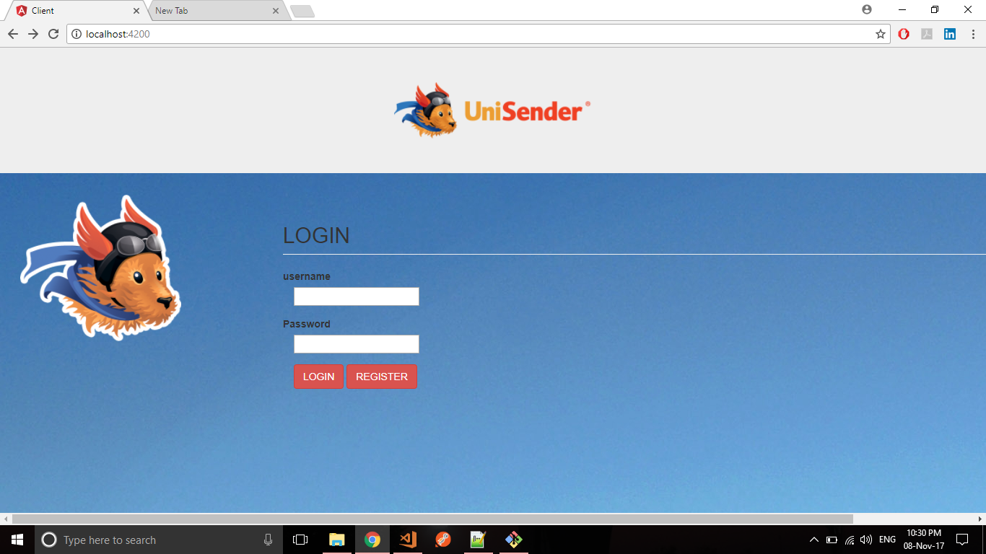
LOGIN PAGE:

Slide 8
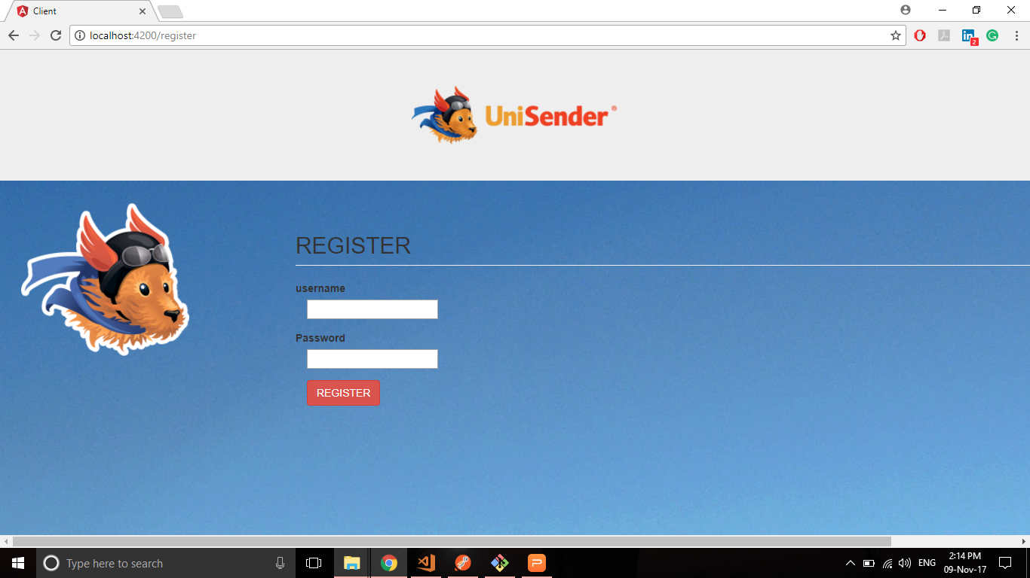
USER REGISTRATION PAGE

Slide 9
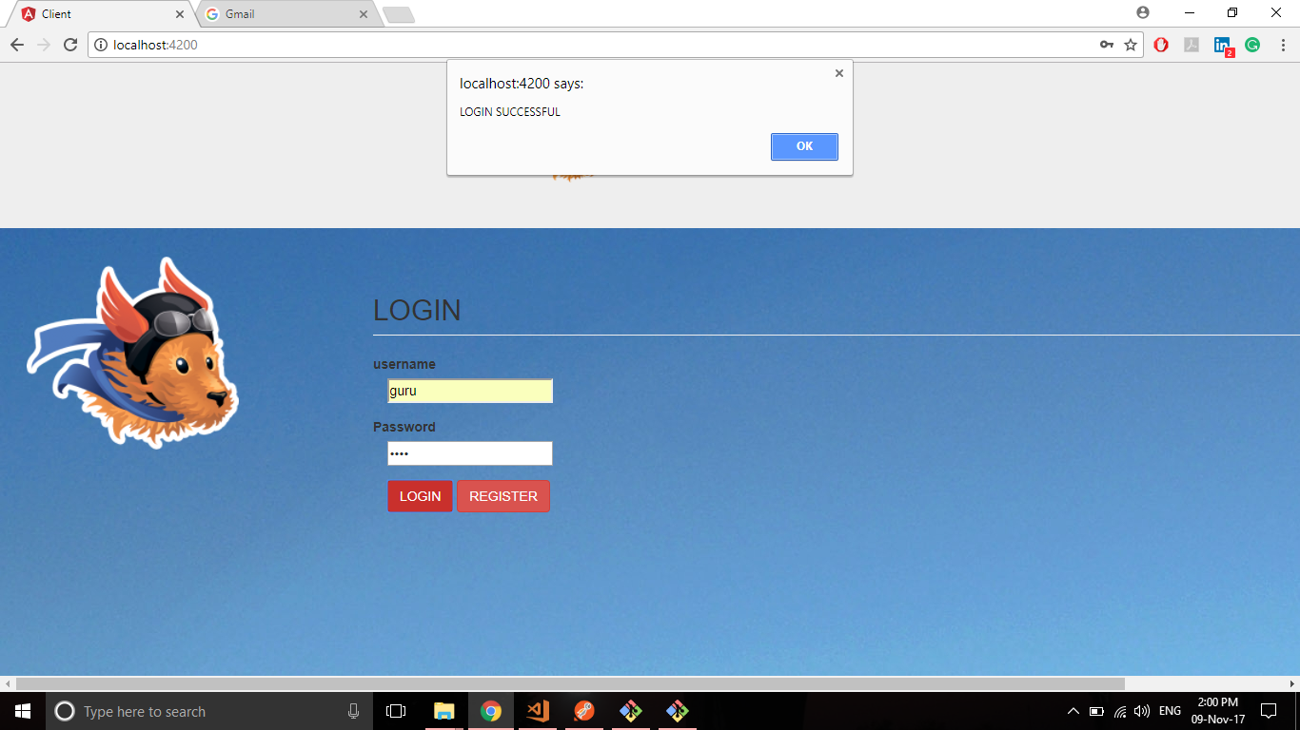
LOGIN SUCCESS MESSAGE

Slide 10
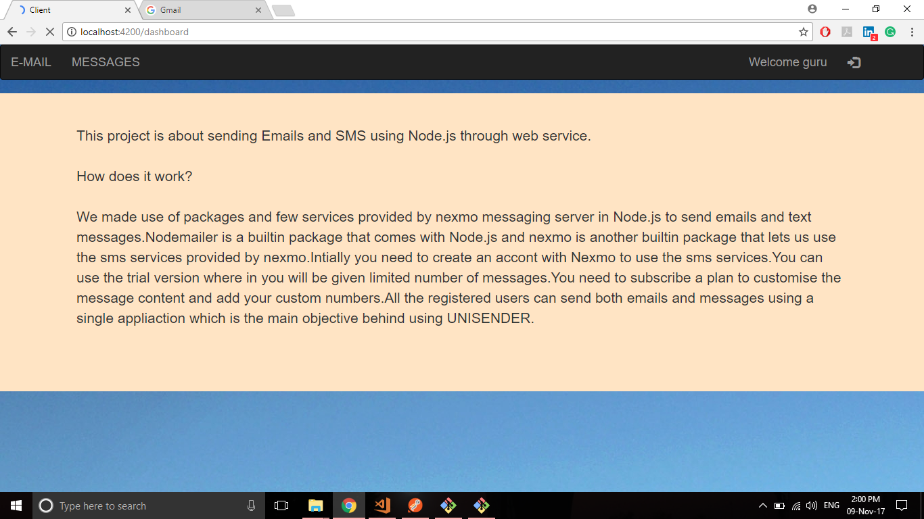
DASHBOARD

Slide 11
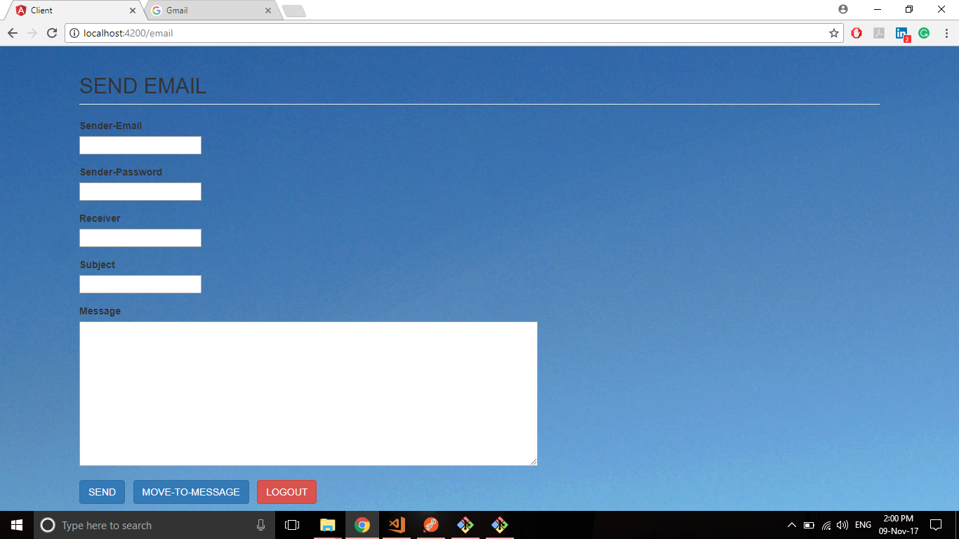
EMAIL COMPONENT

Slide 12
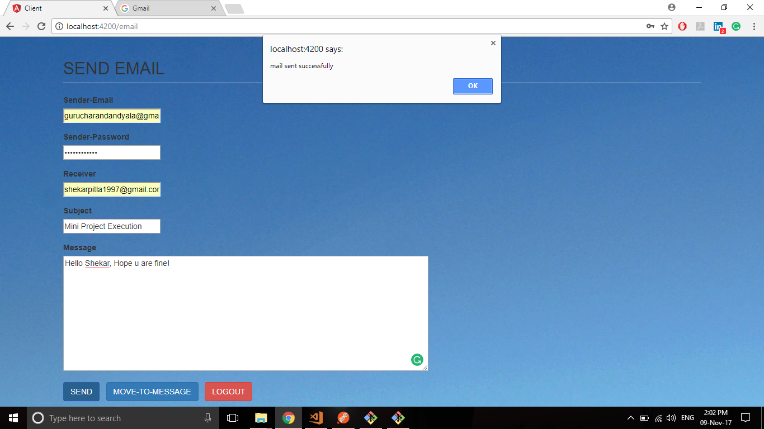
SUCCESSFULY EMAIL SENT MESSAGE

Slide 13
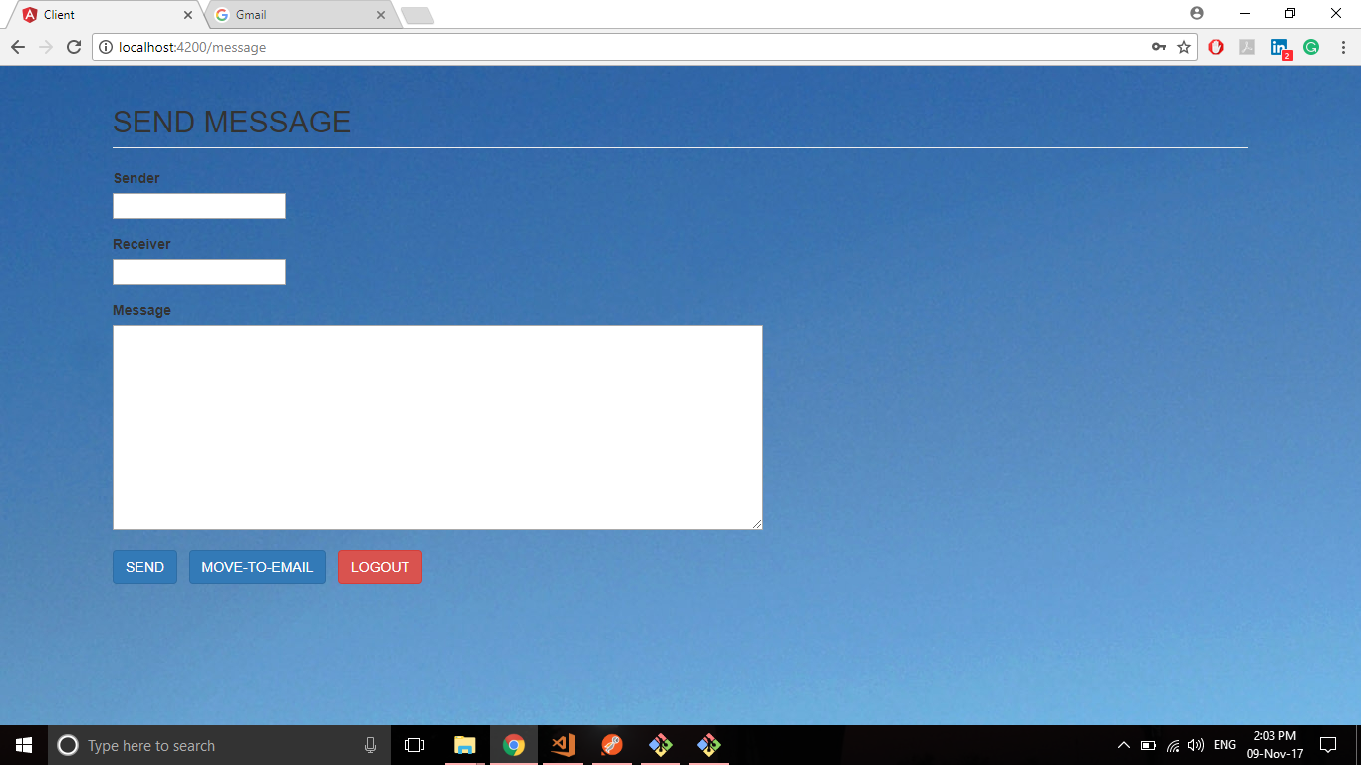
MESSAGE COMPONENT

Slide 14
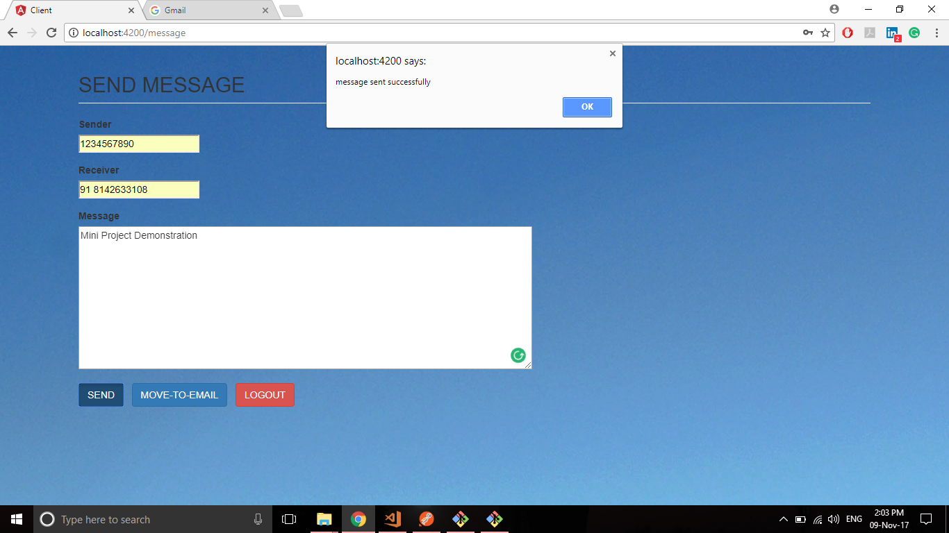
MESSAGE SUCCESSFULLY SENT

Slide 15
THANK YOU!!!

